Slide 1
EPA’s Pesticide Container Regulations: What are EPA and the States Seeing in the Field?
TPSA Conference
Nancy Fitz, U.S. EPA
February 7, 2013

Slide 2
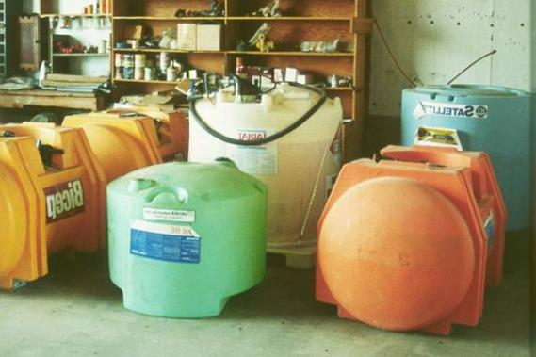
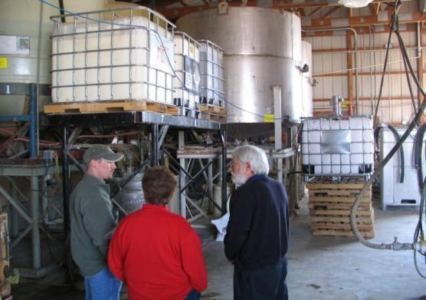
Outline of Presentations
Review container-containment rule
Inspections & enforcement: Who does what?
What are we seeing/hearing?
Frequently asked questions/potential issues

Slide 3
Container-Containment Rule Overview
August 16, 2009
Nonrefillable container (registrants)
Containment (agricultural retailers, commercial applicators & custom blenders)
August 16, 2011
Refillable containers (registrants)
Repackaging (registrants & refillers)
Labels (registrants)

Slide 4
States with Pesticide Containment Regs
CO LA ND
FL MI OH
IL MN SD
IN MO VT
IA MT WA
KS NE WV
KY NH WI
• EPA authorized these 21 States to continue implementing the state pesticide containment regulations in lieu of the federal containment regulations.
• Federal container regulations apply in all States!

Slide 5
Inspections & Enforcement: Who does what?
Containment
21 states: state inspects and enforces
Other states, territories & Indian country: state or EPA inspects; EPA enforces
Containers
Generally, state or EPA inspects; EPA enforces
Like producer establishment inspections
Observations from WI DATCP
A few states have adopted container regs by reference & can enforce directly under state authority

Slide 6
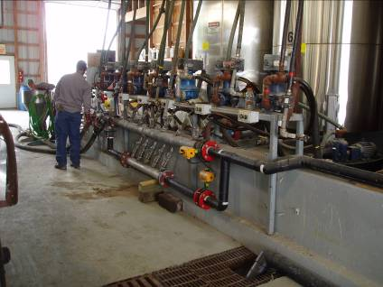
Goals of the Refillable Container & Repackaging Regulations
Ensure the integrity/strength of refillable containers
Minimize the potential for cross contamination
Ensure that containers and repackaging comply with federal pesticide law (FIFRA)
Encourage the use of
refillable containers

Slide 7
Portable refillable containers must:
Be a refillable container that is identified on the registrant’s description of acceptable containers;
Comply with the DOT standards that EPA adopted (generally Packing Group III);
Be durably marked with a serial number/identifying code;
Have a tamper-evident device or a one-way valve (or both) on each opening other than a vent; and
Be sound (in good condition).
[§165.45(e); §165.70(f) & (i)]

Slide 8
What are we seeing?
Over past 3 years, most inspection & enforcement effort has focused on the containment regulations
29 states, territories, Indian country
Only 1 year of refillable container/repackaging inspections and label inspections
All states, territories, Indian country

Slide 9
What are we seeing?
Refillable container & repackaging
Overall: pretty good; most people have made the effort to comply
Possible violations/problems
No repackaging contract
Put wrong (old) label on minibulk
Marking/leakproofness testing
Records

Slide 10
What are we seeing?
Labels
Overall: A lot of work to change all labels
Possible violations/problems
Not having all of the new required language
Cannot tell if it is a nonrefillable or refillable container

Slide 11
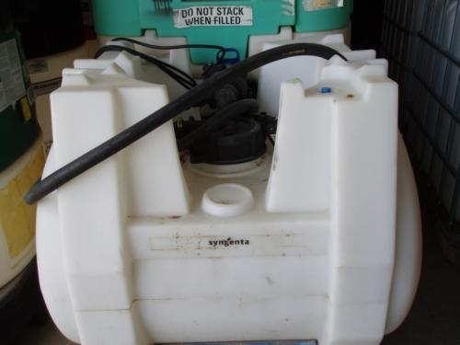
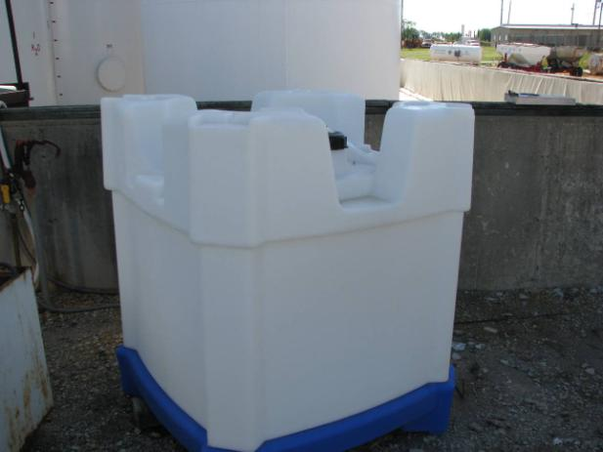
Frequently Asked Questions and Potential Issues

Slide 12
1. Is the Mini Bulk/IBC subject to EPA’s container regulations?
The container is not subject to any of the pesticide container or repackaging regulations and is not required to have a pesticide label. (EPA does not regulate service containers.) However, EPA believes it is a good management practice to ensure the contents of the service container are identified and the pesticide label is available to the applicator. DOT and OSHA requirements may apply to the service container.
Is the container going to be filled as a service container (when an applicator transfers pesticide into a container for the purposes of that applicator applying the pesticide) or to sell or distribute the pesticide?
Service container
Sell or distribute
The container is subject to the pesticide container and repackaging regulations; the pesticide label requirements; and all other pesticide-related regulations.

Slide 13
Subject to EPA’s regulations?
GROWER brings container
REFILLER fills container
GROWER takes to farm & applies pesticide
Example #1
Yes, this is sale and distribution.
GROWER takes cntr #2 to field & applies pesticide
Example #2
REFILLER fills container
GROWER
transfers pesticide to cntr #2
delivers
container
Yes, this is sale and distribution.
No, container #2 is a service container
COMMERCIAL APPLICATOR fills container
COMMERCIAL APPLICATOR applies pesticide
Example #3
No, this container is a service container.

Slide 14
2. Can a retailer fill a refillable container on a farm and, if so, what are the applicable regs?
Answer: Yes, a retailer can fill a refillable container on a farm as long as all of the conditions for repackaging are met and:
Containers must be properly labeled;
Portable refillable containers must meet all standards; and
Stationary refillable containers must be: on description of acceptable containers; durably marked with a serial number; sound and properly labeled.
Federal regs do not require containment at farms; state regulations might.

Slide 15
Question 3: Can I refill a container labeled as a nonrefillable container? Answer: No.
The container CANNOT be refilled with pesticide.
Is the container labeled as a nonrefillable container or a refillable container?
Nonrefillable container
Refillable container
The container can be refilled with pesticide if it complies with all relevant requirements.

Slide 16
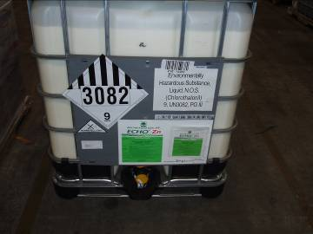
Nonrefillable vs. Refillable Containers
Nonrefillable container: designed & constructed for one-time use and not intended to be filled again with a pesticide for sale or distribution.
Refillable container: intended to be filled with pesticide more than once for sale or distribution.
[§165.3.]
A nonrefillable container will have a label that says: “Nonrefillable container. Do not reuse or refill this container.” These containers cannot legally be reused or refilled!

Slide 17
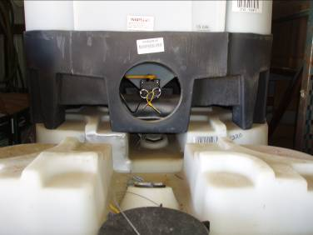
Question 4: Can a minibulk comply with the regulations if it does not have a one-way valve? For example, the valve at the bottom of this minibulk is not a one-way valve. Assume the yellow tie is a tamper-evident device.
• Answer: Yes, a minibulk can comply with the refillable container regulations without having a one-way valve. The requirement is to have a tamper-evident device OR a one-way valve on each opening.
• However, the end user has to break the tamper-evident device to remove pesticide from the minibulk. Therefore, when the minibulk is returned, the refiller must clean the container even if he is filling it with the same pesticide.

Slide 18
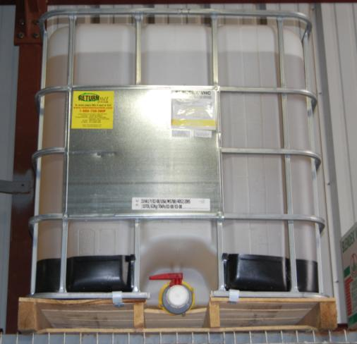
5. Labels/Labeling
Label: written, printed, or graphic matter on, or attached to, the pesticide or device or any of its containers or wrappers. (FIFRA 2(p))
EPA reviews (and approves) the product label as part of registration process.
Some containers have a lot of stickers on them.

Slide 19
Question 6: What is “durable marking” for the serial number/other identifying code?
Answer: Durable marking includes, but is not limited to, etching, embossing, ink jetting, stamping, heat stamping, mechanically attaching a plate, molding, and marking with durable ink.
Each refillable container must be marked in a durable and clearly visible manner with a serial number or other identifying code.

Slide 20
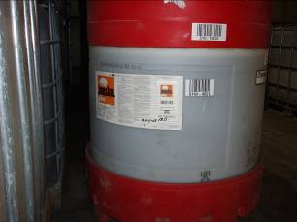
Question 6 (cont.): What is “durable marking” for the serial number/other identifying code?
Durable marking includes an adhesive label if it is securely attached = can reasonably be expected to remain affixed during the foreseeable conditions and period of use. [§156.10(a)(4)]
Serial number can be marked using a marker with durable ink, such as a sharpie, as long as it is marked in a “durable and clearly visible manner.”

Slide 21
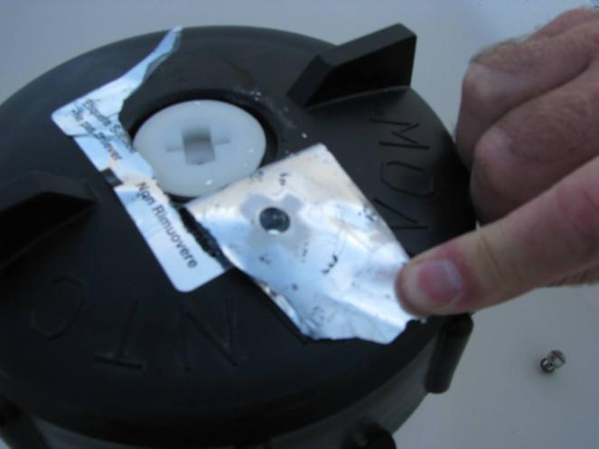
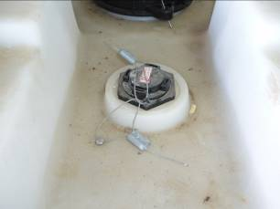
Question 7: What counts as a tamper-evident device? Answer: Tamper-evident device means a device which can be visually inspected to determine if a container has been opened. [§165.3]

Slide 22
Question 7, cont.
Goal of the requirement: to give refillers reasonable indication about whether substances other than the pesticide product for which the containers are labeled may have been introduced into the containers.
While a standard clear zip tie may meet the definition, pesticides in containers that bear tamper-evident devices that do not appear secure and are easily “fakeable” may be subject to heightened enforcement scrutiny to insure the integrity of the pesticide.

Slide 23
Question 8: What recordkeeping does a refiller have to do?
Answer: A refiller must keep:
A copy of the repackaging contract, the refillable container residue removal (cleaning) procedure & description of acceptable containers.
Each time a container is refilled, records of the: (1) EPA Reg. No. of the pesticide; (2) date; and (3) container identifier.
If the refiller does DOT inspections and leakproofness tests, records of the results of those DOT inspections and tests.

Slide 24
For More Information
Environmental Protection Agency (EPA)
http://www.epa.gov/pesticides/regulating/containers.htm
Nancy Fitz, 703-305-7385; fitz.nancy@epa.gov
American Agronomic Stewardship Alliance (AASA)
http://www.aginspect.org/USEPA.html
CropLife America (CLA)
http://www.croplifeamerica.org/PCC-Rule
Mid America CropLife Association (MACA)
http://www.maca.org/edu
Pesticide Stewardship: See Container Handling for inspection video
http://pesticidestewardship.org/Pages/default.aspx
The Pesticide Stewardship Alliance
http://tpsalliance.org

Slide 25
Questions?
Nancy Fitz
703-305-7385
fitz.nancy@epa.gov

